Slide 1

UNH SEDS
CEPS Engineering Organization
High Power Rocketry

Slide 2
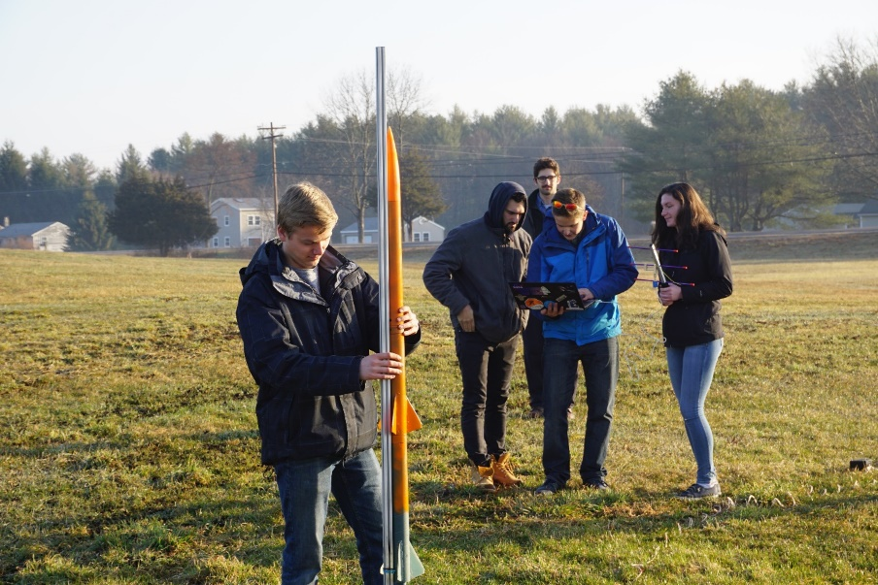
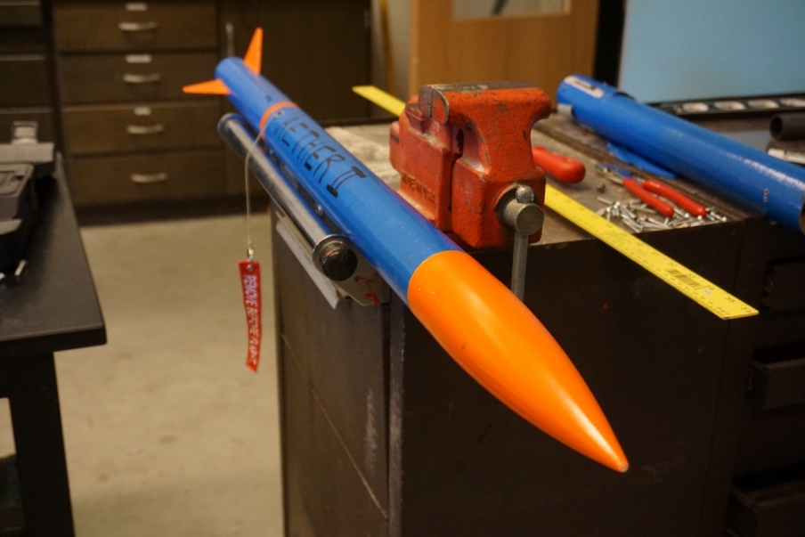
What is UNH SEDS?
Students for the Exploration and Development of Space (SEDS) is a non-profit that empowers young people to participate and make an impact in space exploration. SEDS helps students develop their technical and leadership skills by providing opportunities to manage and participate in national projects as well as to attend conferences.
We are an interdisciplinary rocketry organization founded in 2017 that has 30 members from 6 different majors and every class.
Notes:
Seds is a naitionwide organization that allows colleges from around the world to start a chapter. Although we are allowed to do whatever we would like as an organization, they do sponsor competition for SEDS groups as well as national conferences, the next one for the beginning of November. We are a team comprised of many majors and all classes, so applying to join our team would not only be a senior project, but an interdisciplinary experience.

Slide 3
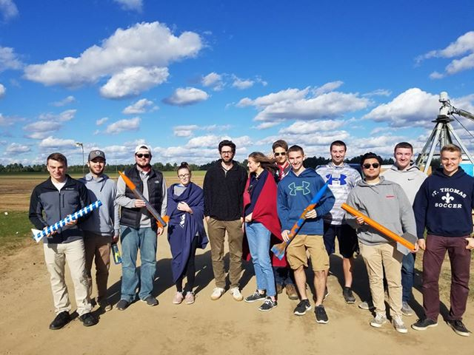
Our history
UNH SEDS has been around for 5 semesters. During that time we have completed 3 classes of rockets and are currently working on a hybrid engine rocket utilizing a liquid oxidizer and a solid fuel.
Experimental Class
Consisting of 2 Rockets.
Aether Class.
Consisting of 7 Rockets.
USRC Carbon Fiber Class.
Consisting of 1 Rocket.
Hybrid Engine Rocket.
Current production.

Slide 4
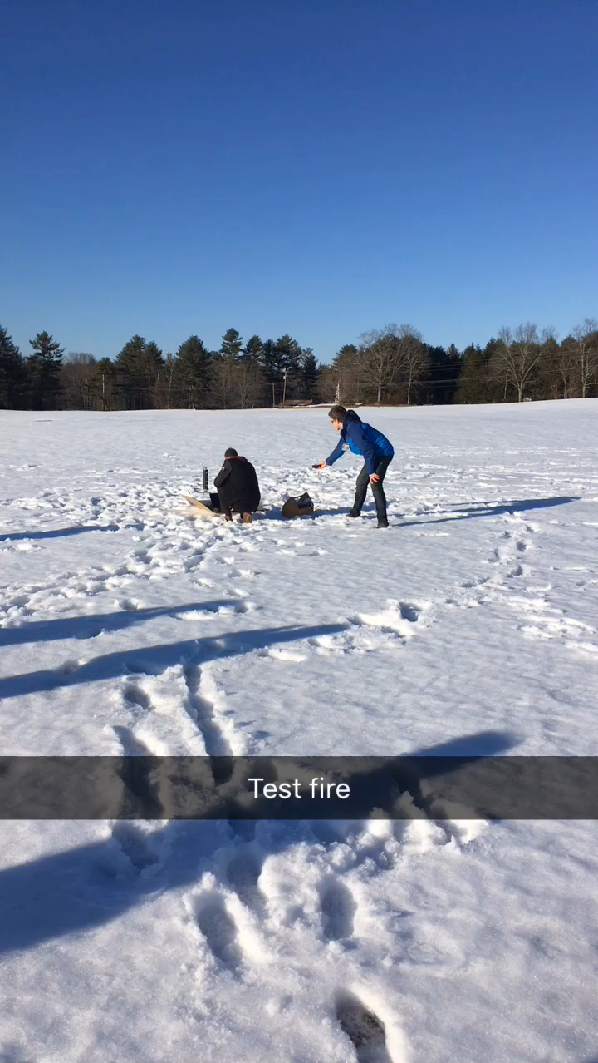

Examples…
Our static test fire for our competition booster engine
Our first successful multistage rocket

Slide 5


Slide 6
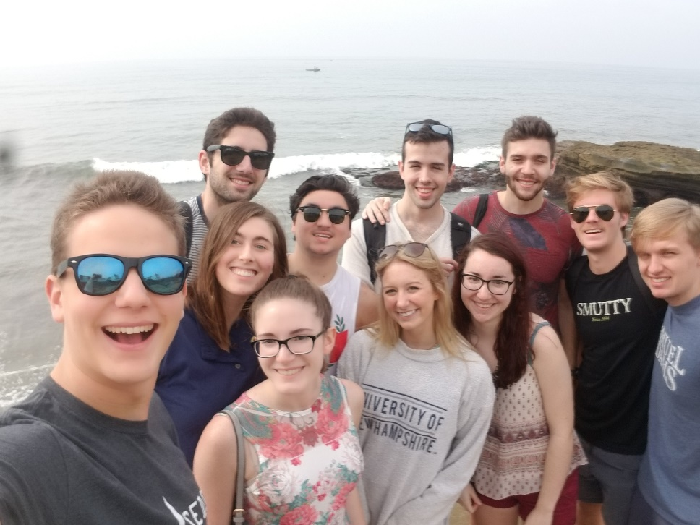
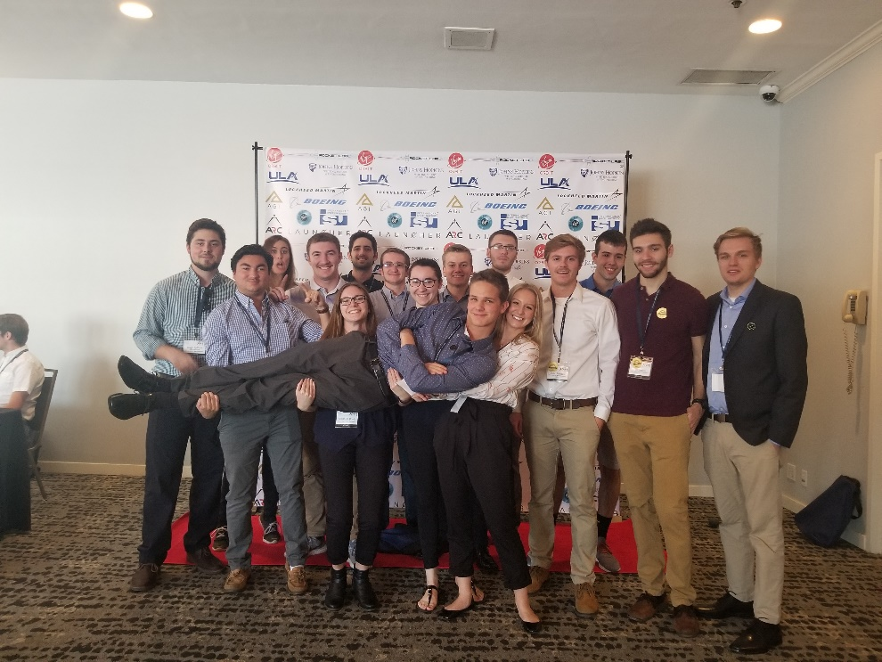
Space Vision
SEDS USA hosts a national conference every year called ‘SpaceVision’ where many of the various SEDS chapters congregate to network and listen to speakers. This year, it was on November 2018 in San Diego, California. We brought 16 of our members to take part in the event.
Notes:
EE major too

Slide 7
Senior Design
Hybrid Engine

Slide 8
Project Overview
Students for the Exploration and Development of Space (SEDS)
Second year organization
Main focus to design hybrid rocket engine
Apply it to rocket mechanics from last years knowledge
Spaceport America Cup - June 2020 in Las Cruces, New Mexico
10,000 ft altitude student researched and developed hybrid class
Target apogee 10,000 feet
Design and manufacture our own static test fire rig
Test, analyze, optimize
https://www.youtube.com/watch?v=lTKRDd1ovAs

Slide 9

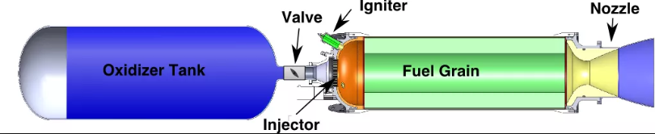
What is a Hybrid Engine Rocket?
Rocket is propelled via solid and liquid components
HTPB Rubber and Nitrous Oxide
Nose Cone
Parachute
Oxidizer
Centering Rings
Injector Plate
Combustion Chamber
Stabilization Fins
Nozzle

Slide 10
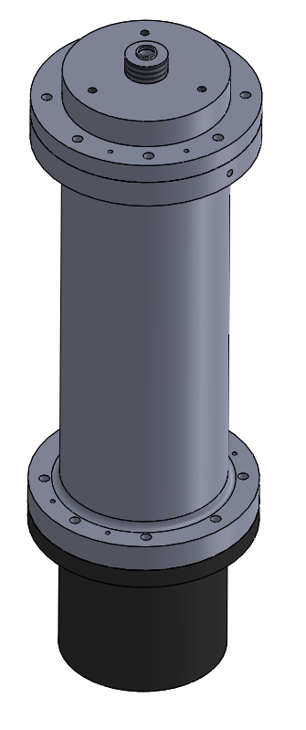
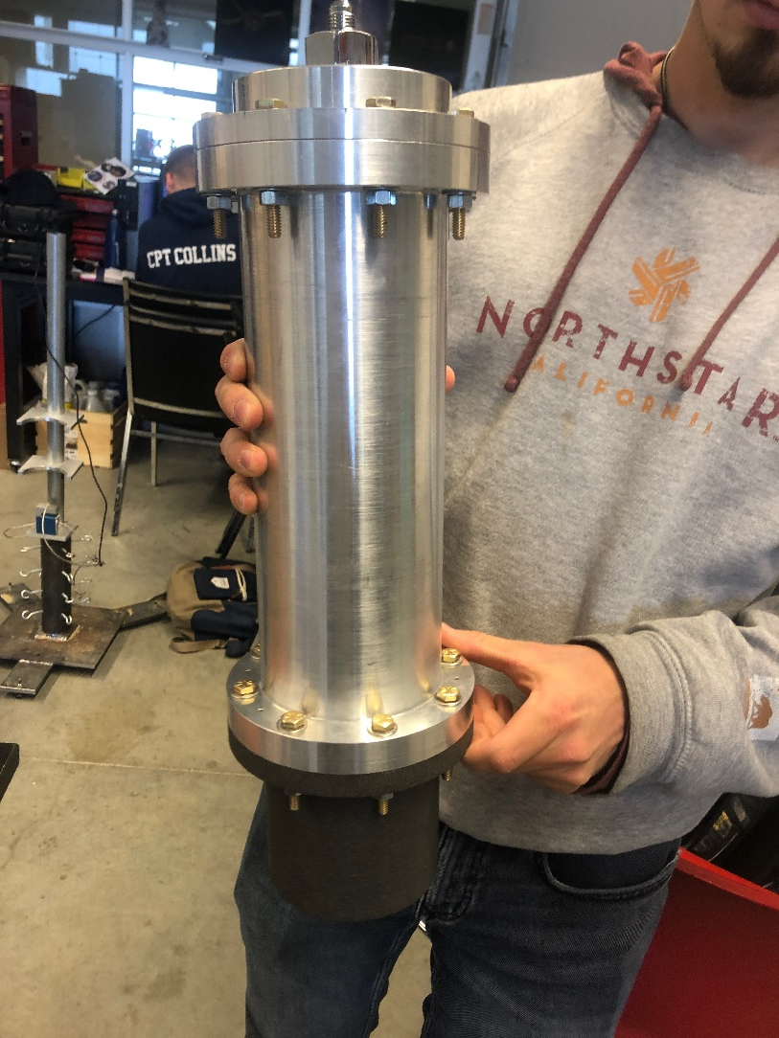
Hybrid Engine Design
Components:
Injector plate - Aluminum 6061
Combustion - Aluminum 6061
Nozzle - Graphite

Slide 11
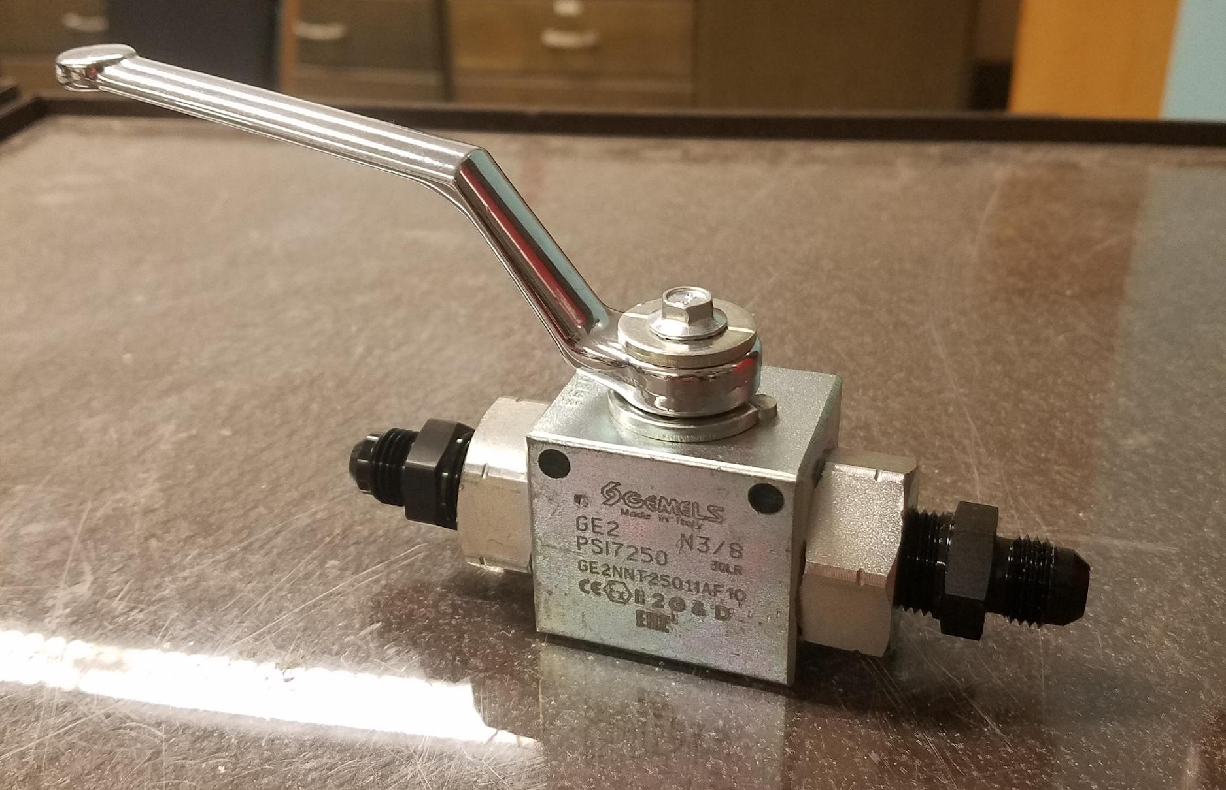
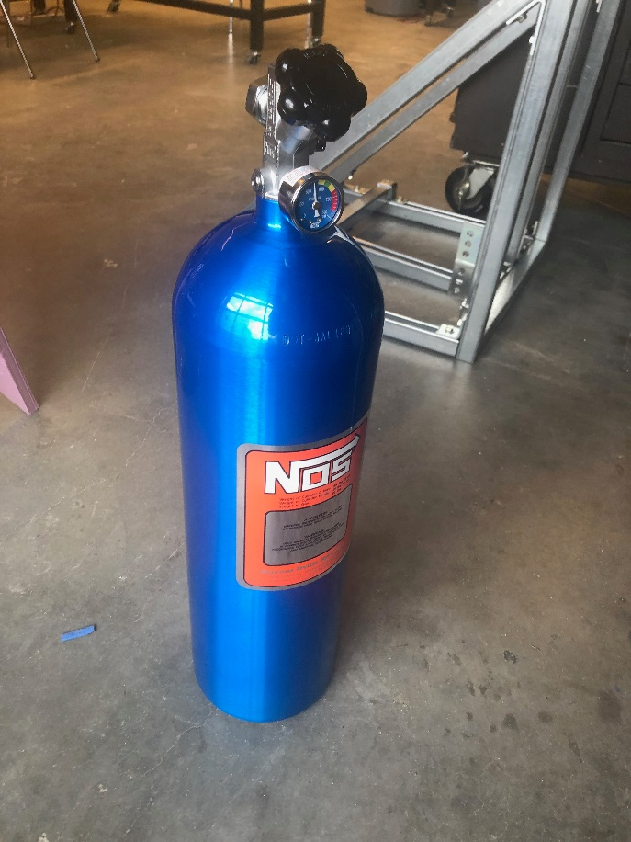
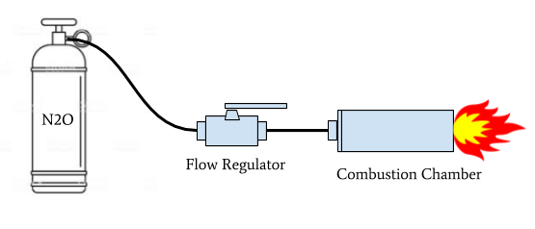
Injection Method
Oxidizer flows from tank through regulating valve controlled by servo motor and into injector plate

Slide 12
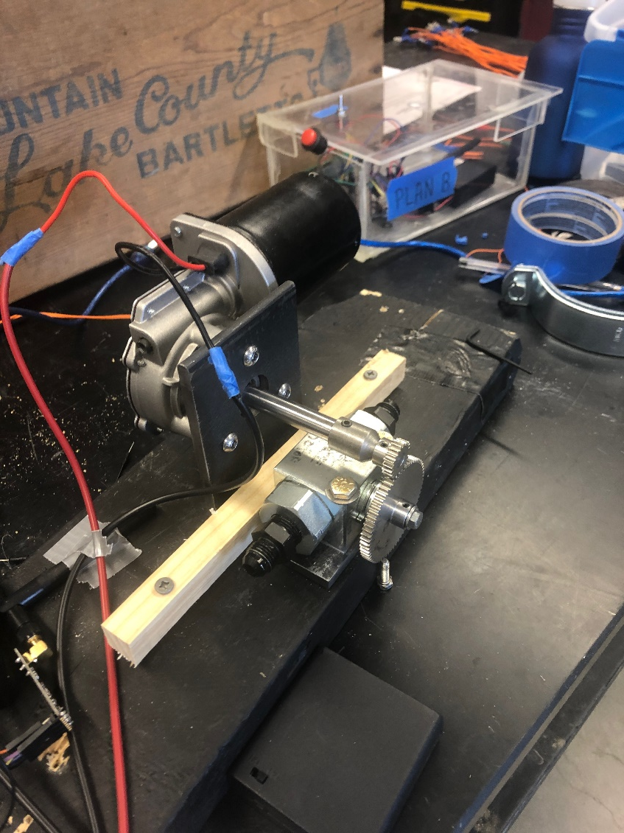
Flow Regulation
Create a way to open and close flow of oxidizer.
Electric motor is programed to open Valve.
Allows for full control over flow and altitude of rocket.

Slide 13
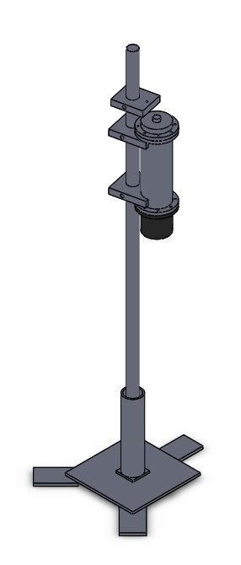
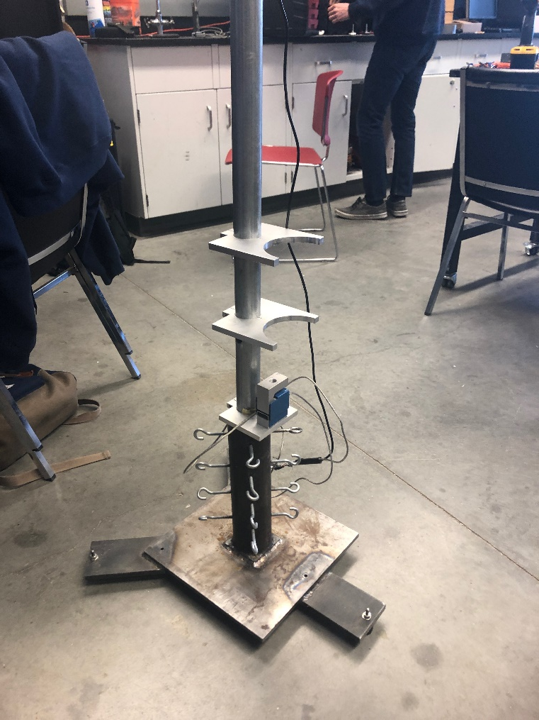
Static Test Fire Rigs
Used to test and measure thrust & combustion temperature, etc.
Trial-and-error process to optimize design components

Slide 14
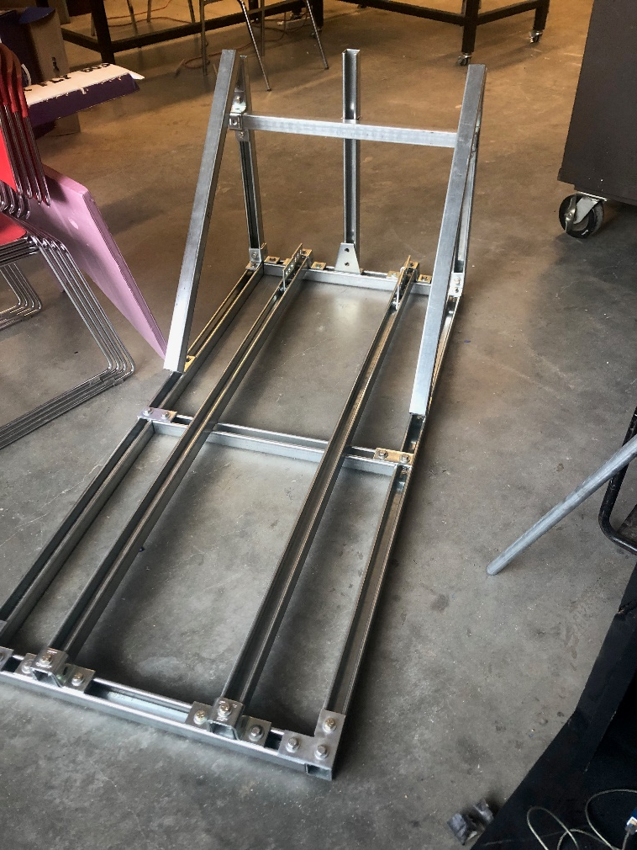
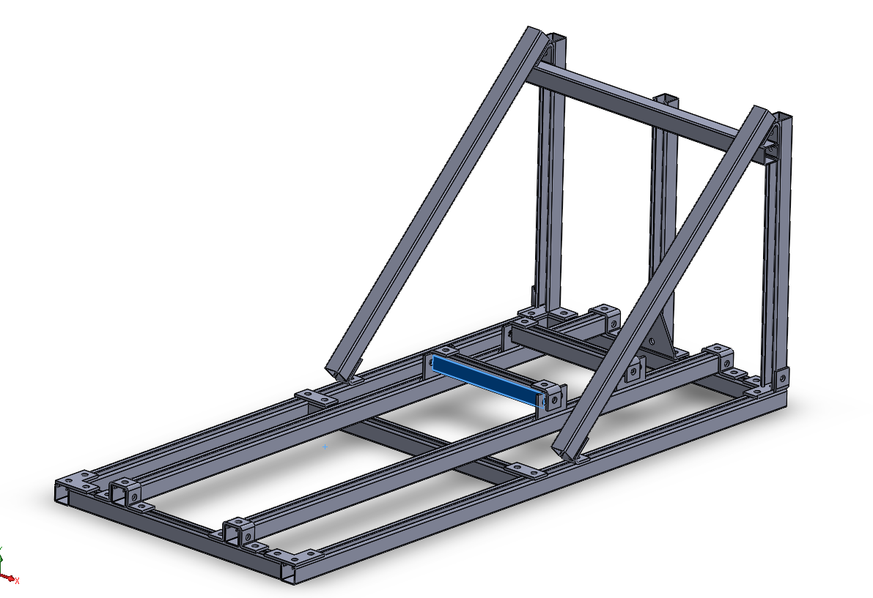
Optimize Ideas
Ex) New Static test fire rig

Slide 15
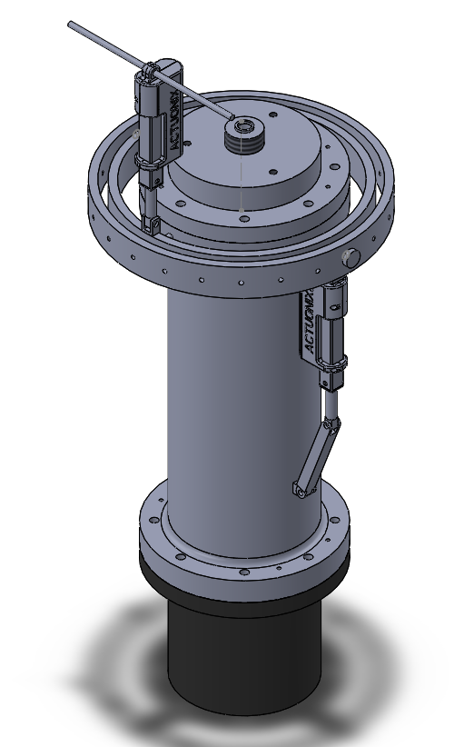
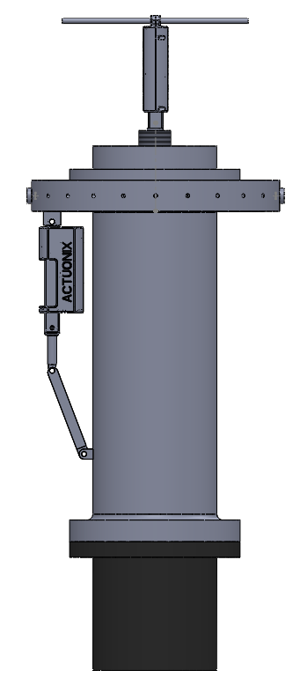
Gimbal System
Being able to control flight path of the rocket.
Controlled by two actuators.
Eventually get rid of rocket body fins to cut down weight of the rocket.

Slide 16
Future Obstacles/ Challenges
Successful engine test
Data collection and interpretation
Gimbal manufactured and Proof of Concept
Safety!

Slide 17
Questions?

Slide 18
Interested in Joining?
E-mail Carly Benik at cjb1070@wildcats.unh.edu
Name?
Year?
Major?
Why are you interested in joining SEDS?
Would you be interested in traveling to Arizona for Space Vision 2019 November 6th-10th?

